Slide 1
Introduction to Operating Systems
CPSC/ECE 3220 Spring 2020
Lecture Notes
OSPP Chapter 2 – Part A
(adapted by Mark Smotherman and Lana Drachova from Tom Anderson’s slides on OSPP web site)

Slide 2
Kernel
Lowest level of software running on the system
Purpose is to implement protection
Kernel is fully trusted and has access to all the hardware

Slide 3
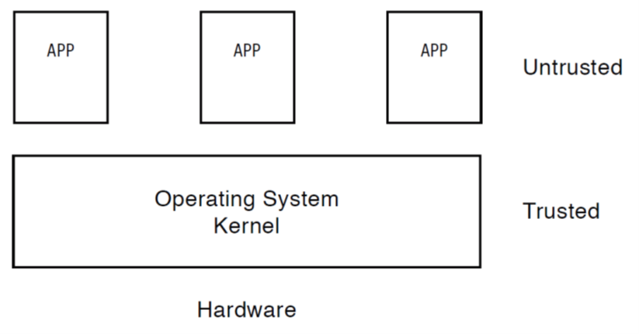
Untrusted Code
We should restrict privileges of untrusted code
Should not have access to all the hardware
Should not have ability to modify the kernel or other applications

Slide 4
Challenge: Protection
How do we execute code with restricted privileges?
Either because the code is buggy or if it might be malicious
Some examples:
A script running in a web browser
A program you just downloaded off the Internet
A program you just wrote that you haven’t fully tested or debugged

Slide 5
Stages of a Program
Source file on disk
Executable file on disk
After compiling and linking
Contains machine instructions (with a specified entry point) and initialized data
Memory image
After loading
Stack, heap, and uninitialized data areas are added to provide a full execution environment

Slide 6
Compiling and Loading a Program

Slide 7
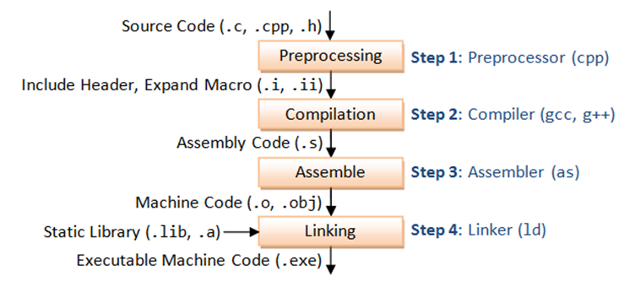
Steps in Compilation
Source: C.H. Chuan

Slide 8
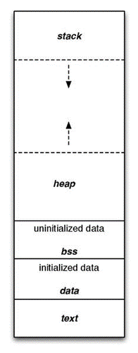
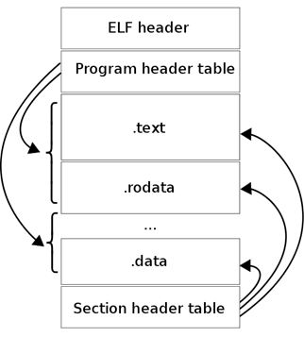
Linking and Loading
Example executable file format
(source: Wikipedia)
.text section is binary machine code
.data section is read-write data (initialized data)
.rodata section is read-only data (initialized data)
Example memory image
(source: Wikipedia)
.bss is “block started by symbol”
.rodata not shown in this diagram
ELF – Executable and Linkable Format – standard executable file format for executable files, libraries and core dumps.
Since 1999 - standard for Unix-like systemsand some others.

Slide 9
Main Points of Chapter 2
Program
sequence of instructions and initialized static data saved in an executable file on a disk.
Process concept
OS abstraction for executing a program with limited privileges
Memory region with instructions, data, stack and heap.
Dual-mode operation: user vs. kernel
Kernel-mode: execute with complete privileges
User-mode: execute with fewer privileges
Safe control transfer
How do we switch from one mode to the other?

Slide 10
Process Abstraction
Process: an instance of a program, running with limited rights
Thread: an instance of execution within a process
Potentially many threads per process (for now 1:1)
Address space: the range of valid addresses
Allocated resources: the physical memory, files, and network connections the process can currently access
PCB (process control block) data structure:
Process location in memory Executable location on disk
User running it
Privileges, etc.
Terminology changed over time!!!!

Slide 11
Thought Experiment
How can we implement execution with limited privilege?
Execute each program instruction in a simulator
If the instruction is permitted, do the instruction
Otherwise, stop the process
Basic model in Javascript and other interpreted languages
How do we go faster?
Run the unprivileged code directly on the CPU!
But what can go wrong?

Slide 12
Hardware Support: Dual-Mode Operation
Use mode bit stored in processor status register
PSR is not accessible to user applications
Kernel mode
Execution with the full privileges of the hardware
Read/write to any memory, access any I/O device, read/write any disk sector, send/rcv any packet
User mode
Limited privileges
Check each instruction before executing
Run only those granted by the kernel

Slide 13
What Hardware support is needed?
To ensure protection from other applications and users and
To run directly on a CPU we need:
Privileged Instructions
Memory protection
Timer interrupts

Slide 14
Hardware Support: Dual-Mode Operation
Privileged instructions
Available to kernel
Not available to user code
Limits on memory accesses
To prevent user code from accessing other process’ data and overwriting the kernel
Timer
To regain control from a user program in a loop
Need safe way to switch from user mode to kernel mode, and vice versa

Slide 15
Privileged instructions
Examples
Change mode bit in processor status register
Change which memory locations a user program can access
Send commands to I/O devices
Jump into kernel code
What should happen if a user program attempts to execute a privileged instruction?

Slide 16
Privileged instructions
Examples
Change mode bit in processor status register
Change which memory locations a user program can access
Send commands to I/O devices
Jump into kernel code
What should happen if a user program attempts to execute a privileged instruction?
Processor exception
control transferred to OS exception handler in OS, process holts.

Slide 17
Non-Privileged (“Safe”) Instructions
Examples
Load, store
Add, subtract, …
Conditional branch, jump to subroutine, …
Allowed to execute in both kernel and user mode
OS and applications all need the ability to add numbers!
OS and applications all need the ability to use loops and call subroutines!

Slide 18
Valid Instructions
User mode: non-privileged (“safe”) instructions only
Kernel mode: both privileged and non-privileged instructions

Slide 19
Invalid Instructions
Attempt to execute a privileged instruction in user mode?
Stop the application and alert the OS!
Typically the attempt is an error, but for selected instructions we will use this response to intentionally invoke the OS

Slide 20
Memory Protection
The role of OS is both security and privacy.
Is read-only access harmless ?
File system buffer can contain user data
Memory can contain passwords
How can you control memory access?
Many approaches

Slide 21
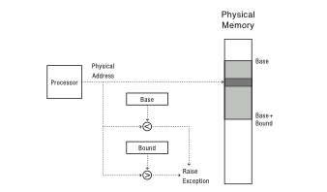
Simple Early Memory Protection
Base register – the start of memory region in physical memory
Bounds register – the end of memory region in physical memory
User-level code cannot change them
Kernel executes without base/bound registers
“Hello world” copied into screen buffer
Physical address generated by processor is range-checked against top and bottom limits

Slide 22
Missing Features
Expendable Stack and Heap
Stack grows to the depth of the procedure call graph
Heap holds dynamically allocated objects
Grow towards each other
Memory Sharing
Processes running the same program
Processes share the same library
Physical memory addresses
Executable file addresses start at 0
Addresses of procedures and global variables need to be adjusted
Every time program is loaded into physical memory
Memory fragmentation
Multiple processes running in the system can fragment memory
Sufficient aggregate memory, but insufficient contiguous memory

Slide 23
Preview: A Better Approach
Virtual addressing – a level of indirection
Every process’ memory starts at zero
Hw translates virtual to physical addresses
If stack and heap grow beyond their allocated region – they are moved to a larger chunk of physical address, virtual address is still the same
Transparent to user process

Slide 24
Preview: Even Better Approaches!
Paging and segmentation in Chapter 8
Translation done in hardware, using a table for each process
Table is set up and managed by kernel

Slide 25
Test Program – Determine if OS Runs with Virtual Addresses
#include<stdio.h>
int staticVar = 0;
main() {
staticVar += 1;
sleep(10);
printf ("Address: %p; Value: %d\n", &staticVar, staticVar);
}

Slide 26
Script to Run Processes in Parallel
% cat test.script
./a.out &
./a.out &
./a.out &
wait
echo all done
% csh < test.script
[1] 9453
[2] 9454
[3] 9455
Address: 0x60104c; Value: 1
Address: 0x60104c; Value: 1
Address: 0x60104c; Value: 1
[2] Exit 28 ./a.out
[1] Exit 28 ./a.out
[3] Exit 28 ./a.out
all done

Slide 27
Address Space Layout Randomization
Most OSs randomize virtual addresses of stack and heap every time it runs
Try to print a local variable address using the same code.

